Slide 1
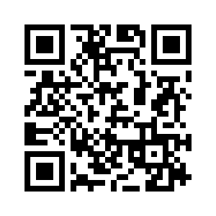
All In One
No QR Scanner
No problem, Go to www.quickservice.me

Slide 2
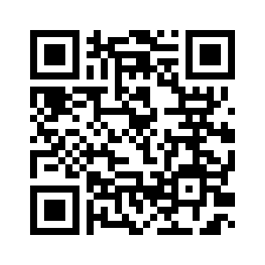
QUICK BITES
No QR Scanner
No problem, Go to www.quickservice.me

Slide 3
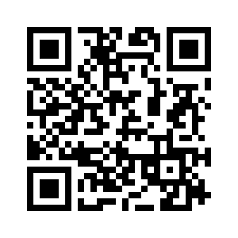
Daily Deli
No QR Scanner
No problem, Go to www.quickservice.me

Slide 4
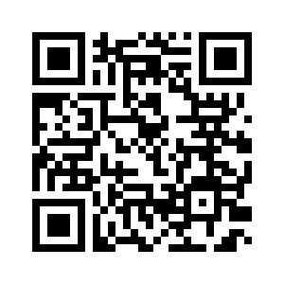
CHAAT
No QR Scanner
No problem, Go to www.quickservice.me

Slide 5
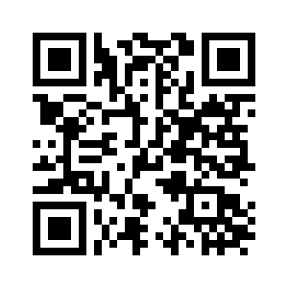
QUENCH
No QR Scanner
No problem, Go to www.quickservice.me

